Slide 1
Comparative study of Robustness in Drowsiness Detection by Adversarial Attacks and Adversarial Retraining
Presentation for Final Project - EL-GY-9163: Machine Learning for Cyber-security
PRESENTED BY
- Moin Khan (mk8793) - Ishan Miglani (im2410)
- Priyanshi Singh (ps4609)
- Siddharth Singh (ss16915)
12/15/2023
Notes:
Our project, titled "Comparative Study of Robustness in Drowsiness Detection by Adversarial Attacks and Adversarial Retraining," extends the work of Gwak et al., - our base paper. While their ensemble algorithms achieved impressive accuracy, our novel approach introduces a custom build CNN model. Through a comprehensive comparative study involving various adversarial attacks, we demonstrate that our custom model exhibits superior robustness and reliability compared to the base model. Imagine a future where traditional systems waver under manipulations; our research aims to bolster these models, ensuring resilience for safer autonomous driving.

Slide 2
Agenda
01
1. Needs 2. Approach 3. Adversarial Attack Techniques 4. Benefits 5. Competition 6. Deliverables 7. References 8. Team Member Contribution
Notes:
Our agenda for today is like a roadmap for our journey in enhancing drowsiness detection. Just as a vigilant driver recognizes the importance of staying alert on the road, we first identify the pressing "Needs."
Our chosen "Approach" is the vehicle, navigating through data landscapes. Along the journey, we encounter challenges – the "Adversarial Attack Techniques." Ultimately, we reach the destination: "Benefits" and insights into the "Competition." The "Conclusion" marks the end, with "References" guiding future travelers and acknowledging "Team Member Contributions" as essential companions on this research road trip. So let’s start ….

Slide 3

Needs (NABC)
Current Limitations
Inadequacies in existing systems: prone to errors under varying conditions.
Safety Risks
Drowsiness leads to significant safety hazards in driving and machinery operation.
Vulnerability to Attacks
Current models are susceptible to adversarial attacks, compromising reliability.
Research Gap
Limited studies on improving resilience against such attacks.
Notes:
Drowsiness detection plays a vital role in modern road safety and autonomous driving. With the increase in accidents due to driver drowsiness, there's a pressing need for more accurate and reliable detection systems. Current models, however, are prone to adversarial attacks, leading to dangerous misclassifications. This highlights a significant gap in research: the lack of robustness in drowsiness detection algorithms against such attacks, a critical issue for the safety of autonomous vehicles. Our research addresses this gap by employing advanced adversarial techniques to enhance the resilience of these algorithms. Imagine a scenario where an autonomous vehicle is navigating a busy highway. A malicious person deploys subtle manipulations, tricking the drowsiness detection system into misclassifying an alert driver as fatigued. As a result, the vehicle fails to recognize a genuine case of drowsiness, posing a severe safety risk. Our goal is to fortify these systems, ensuring safer roads and contributing to trustworthy autonomous driving technologies.

Slide 4
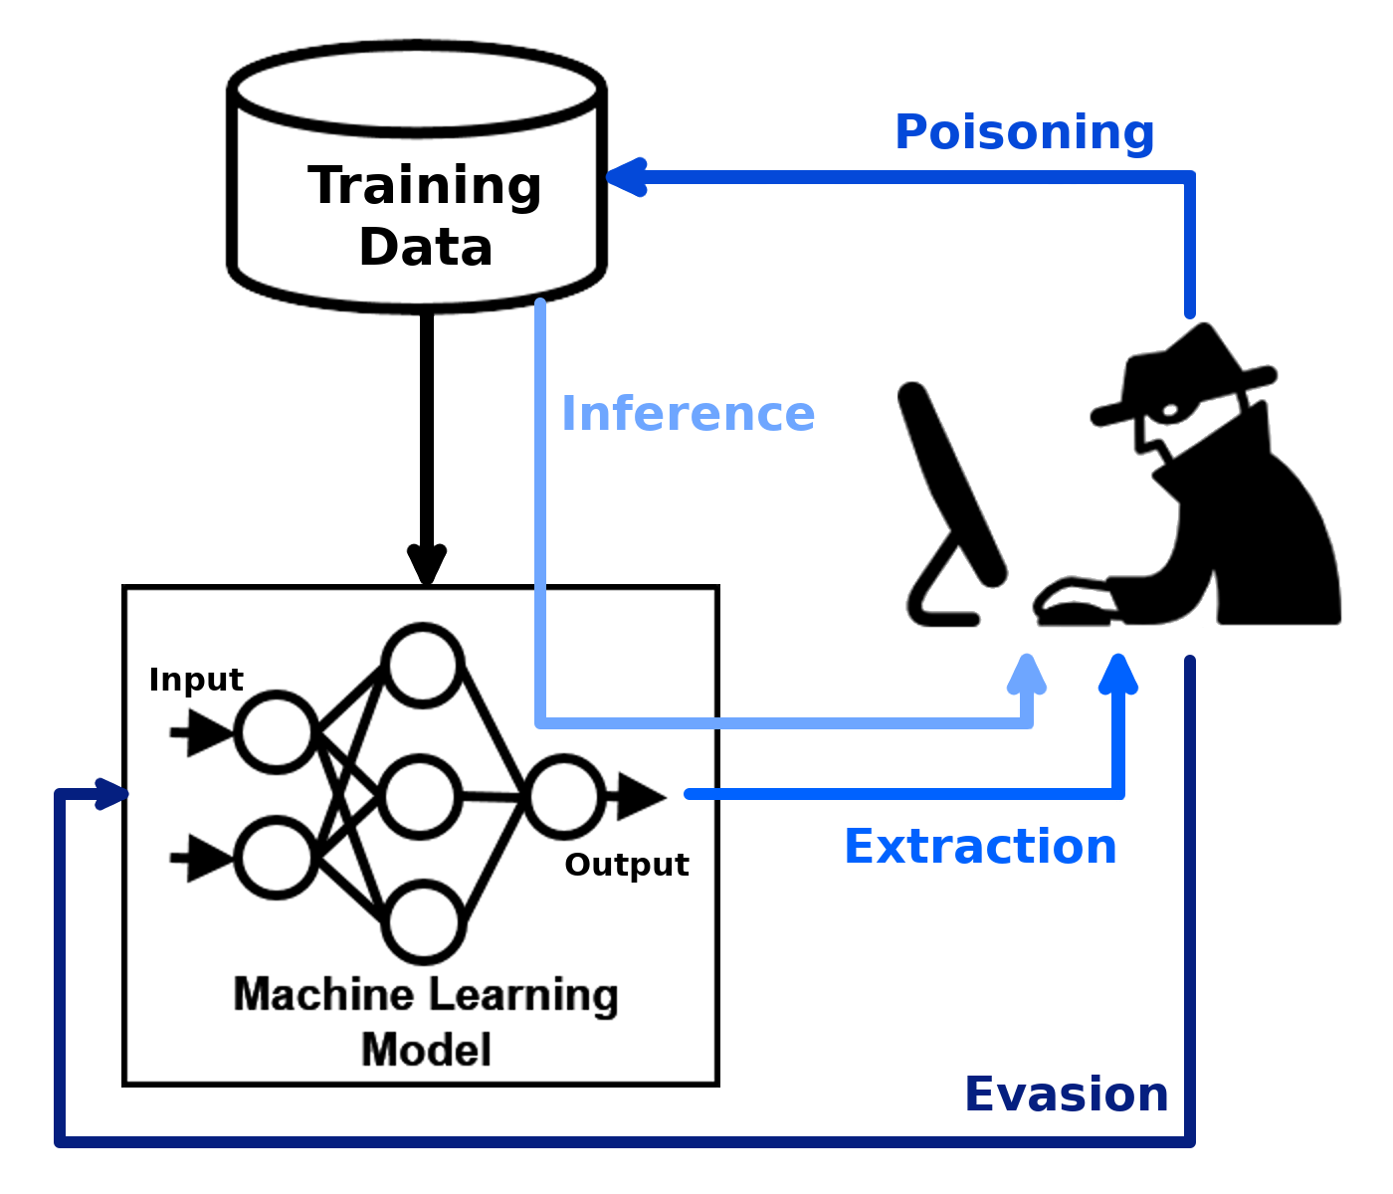
Approach (NABC)
Model Selection
Custom CNN: Our new model for drowsiness detection with 5561922 parameters
Mobilenet v2: A widely-used alternative for comparison with 3360322 parameters
Adversarial Attacks
Implement diverse attacks on both models to assess vulnerability.
Retraining Process
Enhance models using data from these attacks for improved resilience.
Evaluation Criteria
Focus on accuracy, reliability, and resistance to future attacks.
Takeaway:
“Systematic testing and strengthening of models for advanced, reliable drowsiness detection.”
Notes:
In our project, we focus on evaluating and enhancing drowsiness detection systems. We start by selecting Mobilenet v2 model. But we found that it is less robust against adversarial attacks. So, we employ a new Custom CNN model which is much more robust to these attacks. Then both models undergo a series of diverse adversarial attacks to assess their vulnerability and robustness. Following these attacks, we undertake a retraining process, utilizing the data gathered from the attacks to improve the models' resilience. The evaluation criteria for these enhanced models are centered around three key aspects: accuracy in detection, reliability under various conditions, and resistance to potential future adversarial attacks. This comprehensive approach aims to significantly advance the robustness and dependability of drowsiness detection systems.

Slide 5

Adversarial Attack Techniques
Adversarial attacks on machine learning models are subtle manipulations of input data designed to trick the model into making errors. These attacks expose and exploit vulnerabilities, highlighting the need for increased robustness in critical applications where accuracy and security are crucial. Addressing these vulnerabilities is essential for the reliability and trustworthiness of machine learning systems.
FGSM
PGD
Auto-PGD
DDN
Deepfool
Patch
Notes:
So, In our pursuit of enhancing the robustness of drowsiness detection systems, we have implemented various Adversarial Attack Techniques to fortify our model against potential vulnerabilities. Here are the 6 techniques we have explored.

Slide 6
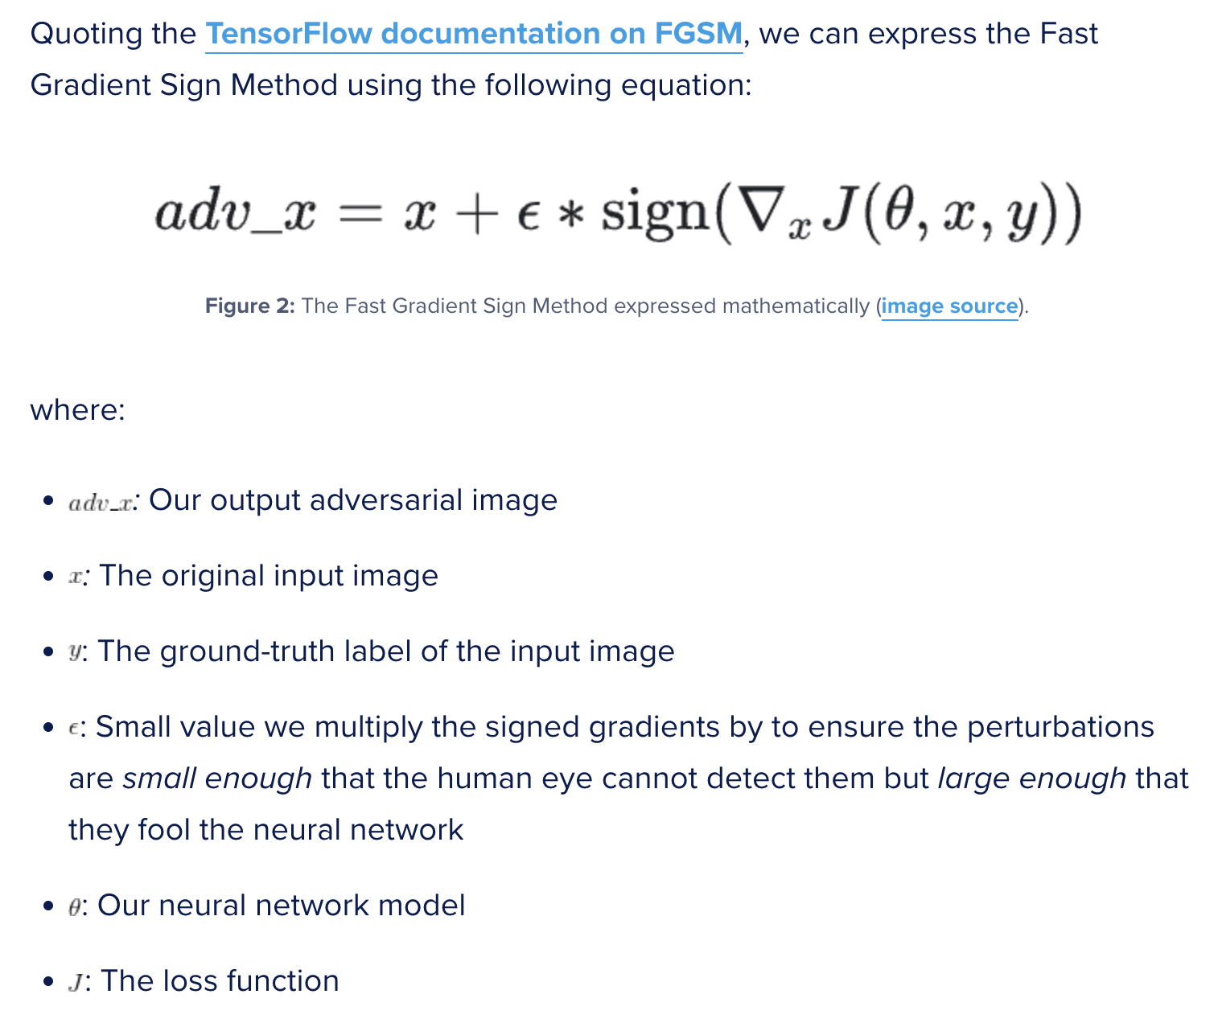
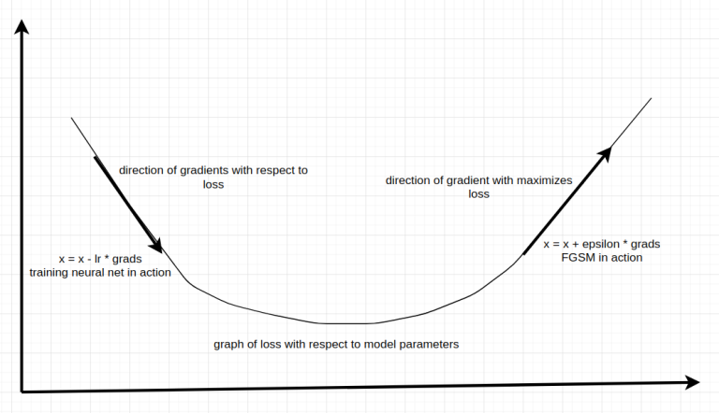
FGSM attack
Notes:
Now, let’s talk about the FGSM attack, also known as (Fast Gradient Sign Method) is a powerful technique for creating adversarial examples, by fooling machine learning models efficiently. By leveraging the gradients of a neural network, it perturbs input data in a direction that maximizes the model's error.
Now, you must be thinking…How does the FGSM work? 1. Computes gradients of a loss function with respect to the input image. 2. For untargeted attack, utilizes the sign of the gradients to create an adversarial image, visually indistinguishable but leading to incorrect predictions. The result is an output image that, according to the human eye, looks identical to the original, but makes the neural network make an incorrect prediction!
Here is the mathematical expression of FGSM fetched from Tensorflow documentation. Adversarial Image(x)=Original Image(x) + ϵ ⋅ sign(∇Image Loss) GRAPH: And, In the graph besides that, we see two arrows representing two different ways of adjusting gradients to achieve a goal. The left-side equation is fundamental in neural network training, where the negative sign ensures the gradient points towards minimizing loss. On the right, the equation manipulates gradients to maximize loss, as in fooling the neural network. Since we want to maximize the loss, we apply the gradients in their natural form.

Slide 7
FGSM attack
Parameters:
epsilon=0.01
batch size=32
Retraining Data - 25% Adv + 100% Clean Training
 | Accuracy (Before retraining) | Accuracy(After retraining)
Model 1 - Mobilenet v2 | 0.84 | 0.514
Model 2 - Custom CNN | 0.945 | 0.962
Notes:
Let’s see some cool results that we found after doing FGSM Attack..
We set out Parameters: - ϵ (Perturbation Strength) to 0.01 and - Retraining Samples to 25%
The Accuracy: (Before / After Retraining) shows that Our Custom CNN demonstrates significantly improved post-retraining accuracy(i.e, 96%) after FGSM attack, outperforming MobileNet V2. This highlights the effectiveness of our approach in enhancing model robustness.

Slide 8
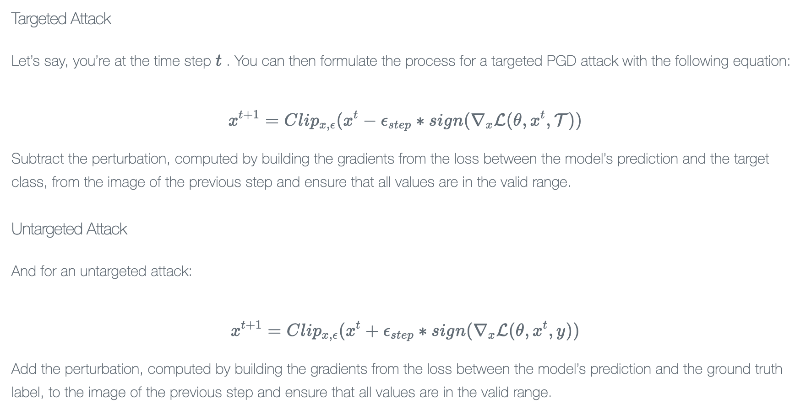
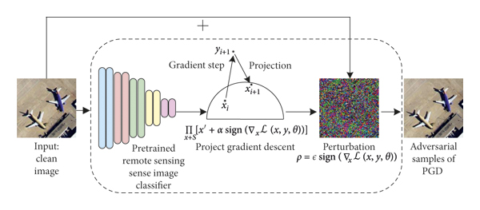
PGD attack
Notes:
The Projected Gradient Descent (PGD) attack is a sophisticated and iterative method used in adversarial machine learning to craft adversarial examples. It enhances the basic concept of the Fast Gradient Sign Method (FGSM) by applying it multiple times with a smaller step size, allowing more precise control over the perturbations added to the input data. PGD operates by projecting the perturbations onto an epsilon-ball surrounding the original input to maintain the subtlety of the changes. This approach makes PGD particularly effective in testing and improving the robustness of machine learning models against adversarial threats, as it can find more intricate ways to deceive models compared to simpler, single-step attacks.

Slide 9
PGD attack
Parameters:
epsilon=0.01
batch size=32
Retraining Data - 25% Adv + 100% Clean Training
 | Accuracy (Before retraining) | Accuracy(After retraining)
Model 1 - Mobilenet v2 | 0.78 | 0.997
Model 2 - Custom CNN | 0.922 | 0.942

Slide 10
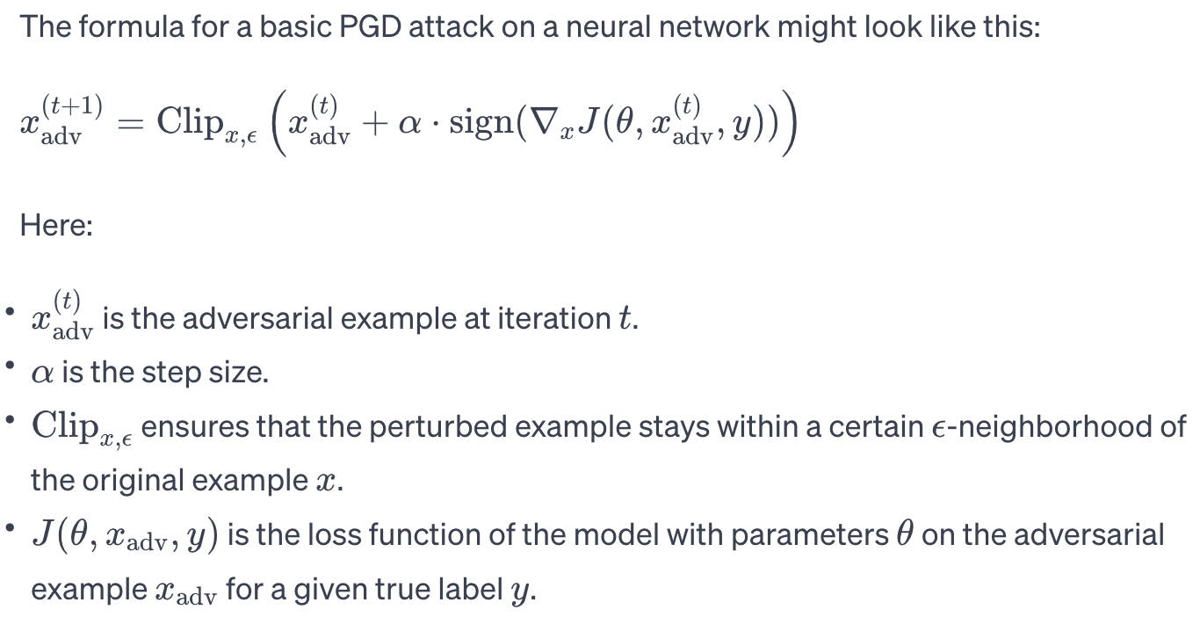
Auto-PGD attack
Notes:
Auto-PGD (Auto Projected Gradient Descent) is an advanced variant of the traditional Projected Gradient Descent attack, tailored for enhanced efficacy in generating adversarial examples. This automated approach optimizes the step size and other hyperparameters dynamically during the attack process, adapting to different models and data points. Auto-PGD is designed to be more efficient and effective than standard PGD, especially in settings where model vulnerabilities are not uniformly distributed across the input space. By automatically adjusting its parameters, Auto-PGD can more effectively probe and exploit the weaknesses of machine learning models, making it a powerful tool for assessing and improving model robustness against adversarial attacks.

Slide 11
Auto-PGD attack
Parameters:
epsilon=0.01
batch size=32
Retraining Data - 25% Adv + 100% Clean Training
 | Accuracy (Before retraining) | Accuracy(After retraining)
Model 1 - Mobilenet v2 | 0.68 | 1.0
Model 2 - Custom CNN | 0.94 | 0.97
Notes:
both PGD and Auto-PGD are iterative methods designed to craft adversarial examples, Auto-PGD introduces a level of automation and adaptiveness in the adjustment of hyperparameters, potentially enhancing the effectiveness and efficiency of the attack across diverse models and scenarios.

Slide 12
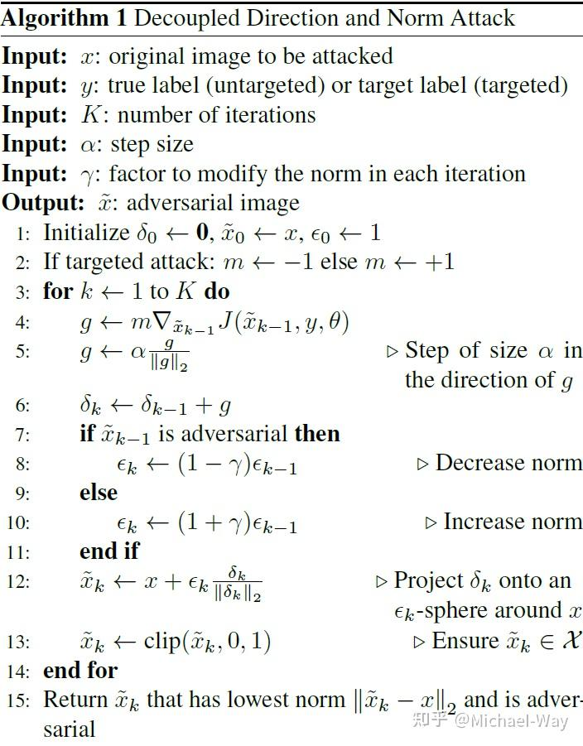
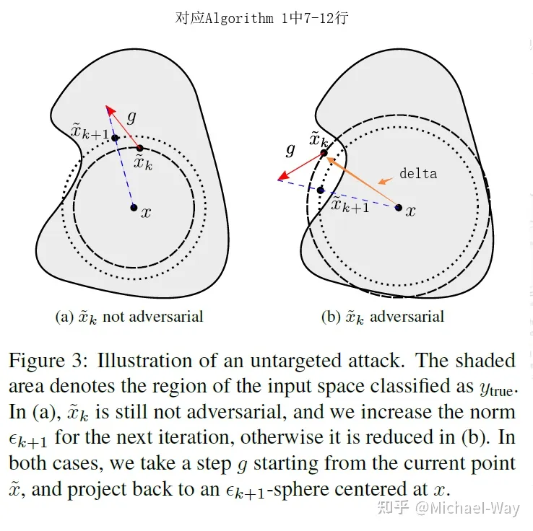
DDN attack
Notes:
DDN Attack - Explanation
Introduction: "The Decoupling Direction and Norm (DDN) attack is a refined adversarial technique in machine learning. It's engineered to probe deep learning models, especially for image classifications."
Technical Approach: "DDN differentiates itself by decoupling the perturbation's direction from its norm. It iteratively adjusts the perturbation vector, finely tuning both its orientation in the input space and its size, optimizing for minimal visibility and maximal classification error."
Compared to FGSM/PGD: "While FGSM makes a single large gradient step and PGD takes multiple, smaller gradient steps, DDN can be thought of as a hybrid approach. It combines FGSM's simplicity with PGD's iterative refinement but adds an extra layer of control over the perturbation's norm, leading to less detectable yet effective adversarial examples."

Slide 13
DDN attack
Parameters:
epsilon=0.01
num_steps=40
Retraining Data - 25% Adv + 100% Clean Training
 | Accuracy (Before retraining) | Accuracy(After retraining)
Model 1 - Mobilenet v2 | 0.824 | 0.9979
Model 2 - Custom CNN | 0.914 | 0.970

Slide 14
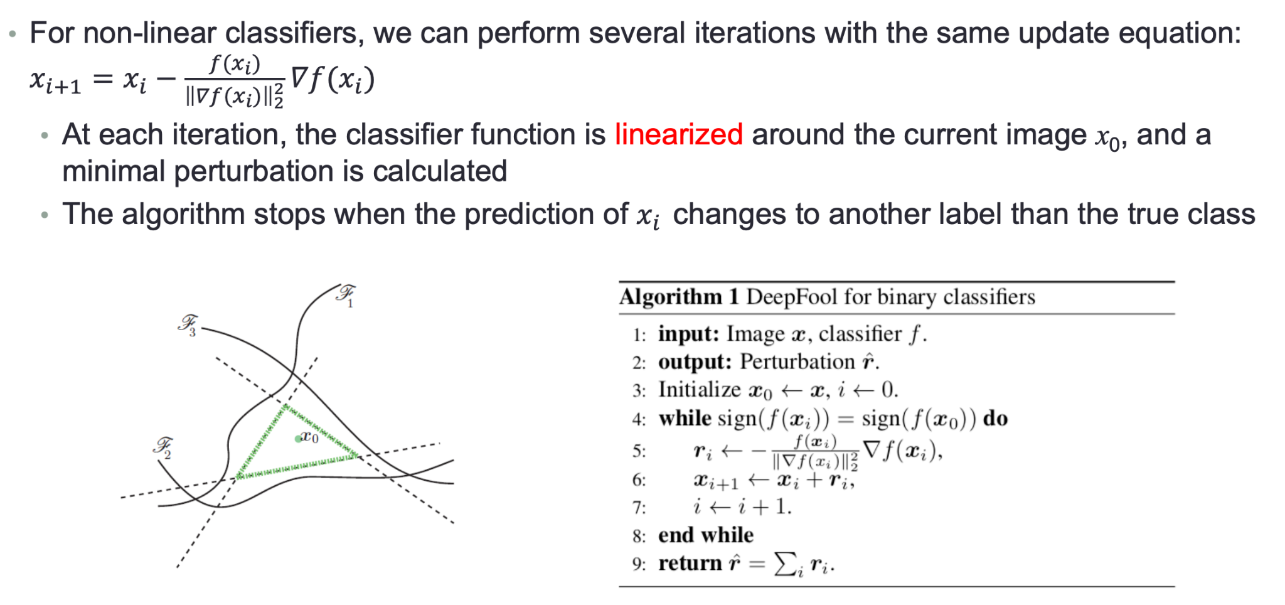
Deepfool attack
Notes:
DeepFool Attack - Enhanced Explanation
Introduction: "DeepFool is a potent, untargeted adversarial attack, known for its efficiency in generating minimal-distortion adversarial samples."DeepFool calculates the shortest path to misclassification,
Technical Approach: "DeepFool approximates a model's decision boundaries linearly to find the least path of perturbation. It iteratively perturbs an input until it crosses the classifier's decision boundary, calculating the shortest route to misclassification while maintaining minimal perturbation magnitude."
Compared to FGSM/PGD: "DeepFool's strategy contrasts with FGSM's blunt single-step approach and PGD's brute-force multi-step method. DeepFool's elegance lies in its precise calculation of the minimal necessary change, making it uniquely effective in unmasking the inherent vulnerabilities of classification models."
Logit-based Approach: "Our implementation of DeepFool utilizes the model's logits, the raw output scores prior to softmax, offering a more direct and unnormalized measure of model decision boundaries for more precise perturbation calculations

Slide 15
Deepfool attack
Parameters:
max_iter=100
Logits models (instead of softmax probability model)
Retraining Data - 25% Adv + 100% Clean Training
 | Accuracy (Before retraining) | Accuracy(After retraining)
Model 1 - Mobilenet v2 | 0.43546 | 0.91
Model 2 - Custom CNN | 0.019 | 0.965

Slide 16
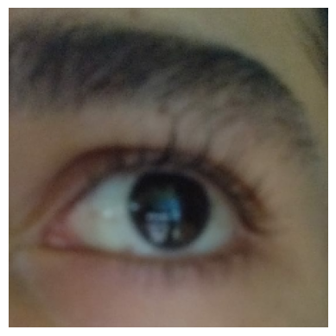
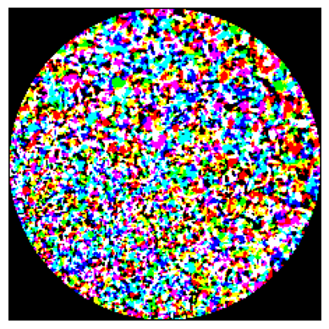
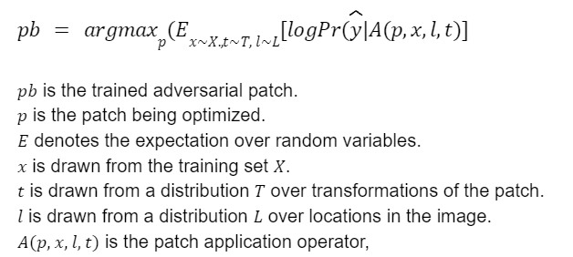
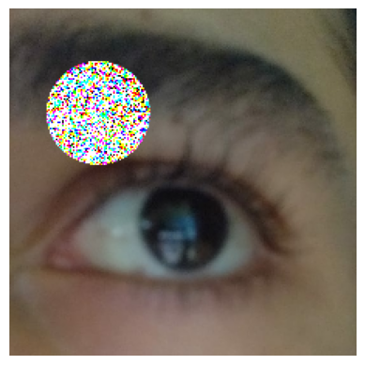
Patch attack
+
Open
=
Closed
Notes:
The Patch attack in machine learning is a type of adversarial attack where a small, often visually distinct, patch is applied to an image to deceive a model. Unlike other adversarial methods that apply subtle changes across the whole image, the Patch attack focuses on a localized area, making it more detectable to the human eye but surprisingly effective against models. This method demonstrates vulnerabilities in models to spatially constrained perturbations and is particularly relevant in scenarios where an attacker can only manipulate a portion of the input, like physical-world attacks.

Slide 17
Patch attack
Parameters:
Images Consider for Patch =100
batch size - 64
learning_rate=5000., max_iter=100
Retraining Data - 25% Adv + 100% Clean Training
 | Accuracy (Before retraining) | Accuracy(After retraining)
Model 1 - Mobilenet v2 | 0.54 | 0.91
Model 2 - Custom CNN | 0.400 | 0.977

Slide 18
Benefits (NABC)
Enhanced Safety
Reduces accident risks with more reliable detection.
Greater Accuracy
Improves model performance in identifying drowsiness.
Increased Resilience
Strengthens defenses against adversarial attacks.
Broader Research Contributions
Offers insights for AI security and robustness.
Wider Sector Application
Useful across automotive, industrial, and healthcare sectors.
Notes:
Our project significantly contributes to enhancing safety in various sectors by developing more reliable and accurate drowsiness detection systems. By focusing on increasing resilience against adversarial attacks, we aim to reduce the risk of accidents, particularly in the automotive industry. The improved accuracy in identifying drowsiness not only elevates model performance but also extends its applicability across industrial and healthcare sectors. Furthermore, our approach provides valuable insights into AI security and robustness, offering broader implications for research in these areas. This multifaceted impact underscores the project's importance in both safety enhancement and technological advancement across diverse fields.

Slide 19
Competition (NABC)
 | Mobilenet V2 |  | Custom CNN
Parameters | 3360322 |  | 5561922
Accuracy | 1.0 |  | 1.0
FGSM | 0.84 | 0.514 | 0.945 | 0.962
PGD | 0.78 | 0.997 | 0.9221 | 0.9423
Auto PGD | 0.68 | 1.0 | 0.94 | 0.97
DDN | 0.824 | 0.9979 | 0.914 | 0.970
DeepFool | 0.435 | 0.91 | 0.019 | 0.965
Patch Attack | 0.54 | 0.91 | 0.400 | 0.977

Slide 20
Deliverables
Completion of the six attacks : As explained in this presentation.
Completion of the C&W Attack & Boundary Attack: Successfully execute the Carlini & Wagner attack and Boundary Attack (a black-box adversarial technique) on the designated models. This involves manipulating input data to deceive the models and documenting the process and outcomes.
Preparation of the Final Report: Compile all findings, methodologies, and results into a comprehensive final report. This report should detail the effectiveness of the attacks, the impact on the models, and the improvements post-retraining.
Compiling and Presenting Final Code in a Repository: Organize all code used for the attacks, retraining, and data visualization. Document and upload it to a version-controlled repository (like GitHub) for easy access, review, and future reference. Ensure that the code is well-commented and includes necessary instructions for replication or further development.

Slide 21
References
Gwak, J., Hirao, A., Shino, M.: An investigation of early detection of driver drowsiness using ensemble machine learning based on hybrid sensing. Appl. Sci. 10(8), 2890 (2020). https://www.mdpi.com/2076-3417/10/8/2890
Mehta, S., Dadhich, S., Gumber, S., Bhatt, A.J.: Real-time driver drowsiness detection system using eye aspect ratio and eye closure ratio. SSRN Electron. J. (2019). https://papers.ssrn.com/sol3/papers.cfm?abstract_id=3356401
Closed Eye in the Wild dataset (CEW) - http://parnec.nuaa.edu.cn/_upload/tpl/02/db/731/template731/pages/xtan/ClosedEyeDat abases.html
Adversarial Robustness Toolbox- https://adversarial-robustness-toolbox.readthedocs.io/en/latest/

Slide 22
Team Member Contribution
- Moin Khan (mk8793) -> Worked on DeepFool and Patch attack. Contributed in developing custom robust CNN and helped in preparing presentation slides, video and report.
- Ishan Miglani (im2410) -> Worked on DDN and Carlini & Wagner Attack (C&W). Contributed in developing custom robust CNN and helped in preparing presentation slides, video and report.
- Priyanshi Singh (ps4609) -> Worked on FGSM and Boundary attack. Contributed in doing a comparative study between the two models and helped in preparing presentation slides, video and report.
- Siddharth Singh (ss16915) -> Worked on PGD and Auto-PGD attack. Contributed in doing a comparative study between the two models and helped in preparing presentation slides, video and report.

Slide 23
Thank you!
Special Thanks To:
Instructors:
- Marco Romanelli
- Alexandre Araujo
- Naman Patel
- Chinmay Nerurkar
Teaching Assistants:
- Chandana Srinivasa: [cs7074@nyu.edu]
- Mahmoud Shabana: [ms9761@nyu.edu]
- Mingzhi Zhu: [mz3379@nyu.edu]
We extend our deepest gratitude to the instructors and teaching assistants for their dedication, expertise, and unwavering commitment to our learning experience. Your guidance and support have been invaluable throughout this journey. Thank you for making EL-GY-9163 an enriching and impactful course.

